Slide 1



Faithfully Personally Congregationally Practically
Canon Mary M. MacGregor
Episcopal Diocese of Southwest Florida
Stewardship Workshop, August 27, 2022
9 am-2:30 pm

Slide 2
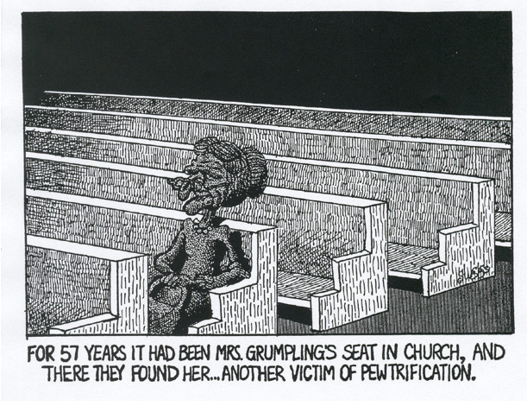

Slide 4
Phases of Change
Denial
Shock, disbelief, closed to reality
Resistance
Anger, grief, mourning, defiance
Commitment
Resolution, adherence
, adapt to the change
Discovery
Open to the possibilities,
exploring, revelation
Communication
Listening, dialog, information sharing, time for thinking things
through
Scott, Jaffee

Slide 5
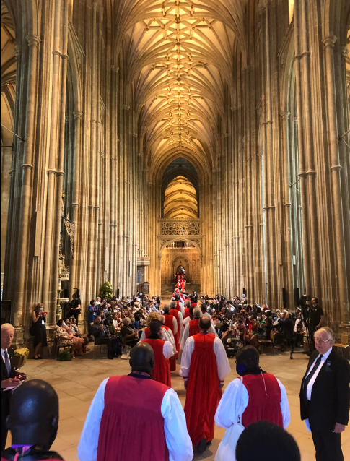

Slide 6
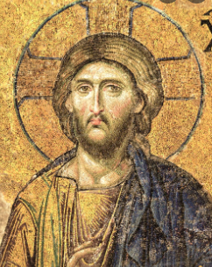
Jesus Christ is the same
yesterday, today and forever.
                Hebrews 13:8

Slide 7
Almighty God, whose loving hand hath given us all that we possess: Grant us grace that we may honor thee with our substance, and remembering the account which we must one day give, may be faithful stewards of thy bounty, through Jesus Christ our Lord.
AMEN
A Prayer for the Right Use of God’s Gifts
p.827 Book of Common Prayer

Slide 8
A Steward:
“One who is entrusted with the management of property, finances or other affairs not his own.”
-Funk and Wagnall’s Dictionary
Notes:
THE GOAL IS THAT ALL CONGREGATIONS WILL TEACH STEWARDSHIP AND HELP EVERYONE GROW IN THEIR UNDERSTANDING OF WHAT IT MEANS TO ACTUALLY LIVE AS FAITHFUL STEWARDS.
SO WHAT IS THE DEFINITION OF A STEWARD, WHAT DOES IT MEAN TO BE A STEWARD?
A STEWARD IS ‘ONE WHO IS ENTRUSTED WITHT THE MANAGEMENT OF PROPERTY, FINANCES OR OTHER AFFAIRS NOT HIS OWN.’ FUNK AND WAGNALLS DICTIONARY
Later in this presentation I am going to speak to the importance of having visuals and tools for helping people understand stewardship. I use the illustration of a basket of apples because I once saw it used as a tool for teaching stewardship during an annual campaign.
First the apples were used as a logo for the campaign. Then from the pulpit, a lay witness got up with a basket of apples and used this illustration:
This is a beautiful basket full of ten apples that God made especially for us. God said, enjoy these apples, eat them, bake them, share them, I am giving them to you for your pleasure and use. You can do whatever you want with them.
However, I would enjoy having one of the ten back, no strings attached, out of gratitude that I gave these apples to you in the first place. What do you think about giving back just one of these and you keeping the rest?
This is a powerful illustration for teaching, also a memorable visual . The particular church where this visual was used did many things well during their annual giving campaign. They used the apple as the symbol of the campaign, they went around to the small groups in the church and took a basket of apples with them, utilizing a list of questions for discussion and then having apple desserts after those stewardship discussions, and they used apples as centerpieces at their stewardship dinner. By the end of the annual giving campaign everyone got the point and I bet many remember it to this day. That year the church raised their average pledge by $300 a pledge.
I use this illustration to say we must go about our annual giving campaigns in new ways. What we want is to……next slide

Slide 9
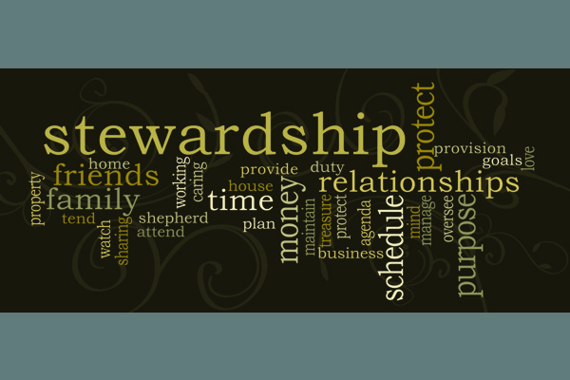
God Entrusts Us to Steward Everything!

Slide 10


Not Equal
stewardship

Slide 11
What Does Scripture Have to Say About Stewardship?
Handout #1
The word ‘steward’ is mentioned in the Bible 20 times
16 of Jesus’ 38 parables dealt with stewardship/stewardship of money
The two topics Jesus spoke the most about were the Kingdom of God and stewardship/stewardship of money

Slide 12
Faithfully

Slide 13
Faithfully
The theology behind giving and generosity lays the essential foundation for understanding stewardship. What does scripture have to say about it? Why does it matter?

Slide 14
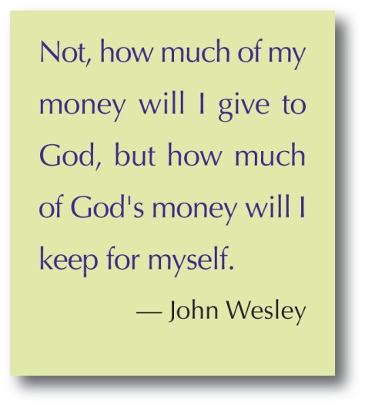
Notes:
The team needs to know each others stewardship story. Yes, reveal where they are in their journey. Everyone on the team needs to be a committed and pledging giver. When the team first forms they need to share their stewardship stories with each other. There may be some members who are working toward giving a tithe, but are percentage givers, stepping up their giving by a percentage each year. They need to share why they are grateful to God and why they want to serve.
The team needs to pray together when they meet and pray for each other and for the congregation and their clergy. Always focusing on God’s movement in these efforts will not only keep them on track but will help them inspire others for stewardship because
Giving is about being inspired to give. No one wants to give out of obligation. EVERYONE wants to be inspired to give.
So what are some of the ways that a stewardship team inspires giving:

Slide 15
Faithfully
Handout #2
Bible Study
“Do not be afraid, little flock, for it is your Father’s good pleasure to give you the kingdom. ³³Sell your possessions and give alms. Make purses for yourselves that do not wear out, an unfailing treasure in heaven, where no thief comes near and no moth destroys. ³⁴For where your treasure is, there your heart will be also.” Luke 12:32-34

Slide 16
Personally
P

Slide 17


Slide 18

What Gets in the Way?
What has gotten in the way of growing deeper in your personal practices of living as a Christian steward and all that God has entrusted to you?

Slide 19
Personal Stewardship Development Requires Relationships
One’s relationship with God in Christ Jesus
An individual’s growing from believer to follower draws us to relationship with other followers
Followers gather and form caring relationships in faith community
God calls faith communities to be in relationship with the world, near and far

Slide 20


Slide 21

Generosity Happens ...
When we release control and allow God to use us as a conduit of His blessing.
Following Jesus in a Culture of Fear-Scott Bader-Saye
Notes:
THIS is a part of everyone’s spiritual journey. To release control and realize that we are only stewards and that God uses us as a conduit of His blessing. This comes from a place of thankfulness, a place of gratitude. Let’s remind ourselves of the role of being thankful….

Slide 22
Handout #3
Independent & Small Group Work
Each of you should use whatever gift you have received to serve others as faithful stewards of God’s grace in its various forms.
1Peter 4:10

Slide 23
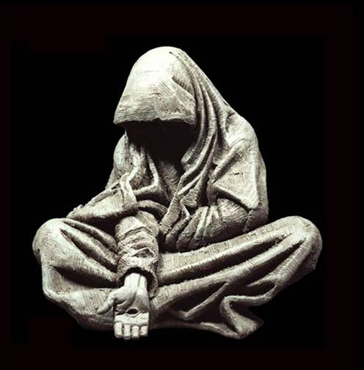

Slide 24
“What makes us rich isn’t what we hold onto but what we give away.”
The Rev. Jim Nutter

Slide 25
Congregationally

Slide 26
Understand Your Church’s
Giving Culture
Spirit of Scarcity or Abundance?
Budget Driven or Driven by Thankfulness and Generosity?
Budget Driven/Scarcity-------------------------------------Thankfulness/Generosity
1 2 3 4 5 6 7 8 9 10
Where is your church on this scale?
Notes:
Those of us who work extensively with congregations clearly see that every congregation has a distinct culture.
That culture is the way you do things around your church and it has been shaped by your congregation’s history and their patterns of behavior. . And every church has a culture of giving.
Some churches have a spirit of scarcity and everyone in the congregation knows they are budget driven. Anxiety about money or the lack there of can be easily raised without much effort.
Their annual beg-a-thon usually goes like this:
About the first week in September the Sr. Warden reminds the vestry that it is their responsibility to run this year’s annual giving campaign. He or She asks for volunteers on the vestry to set up the routine for the campaign. No one volunteers. Then they look around the table to see what vestry member is absent, then assigns the responsibility to run the annual campaign to that person.
Of course we all know the punishment for missing a vestry meeting which is you are volunteered to do work no one else wants to do.
In a congregation such as this their annual campaign usually consists of a letter from the rector, maybe rector and vestry members that notes how tight next year’s budget is going to be and that they are soliciting financial support as a ‘fair share’ from every family unit and enclosed in that letter is a pledge card that you can either bring in on any Sunday in October or mail it in. The word ‘tithe’ might be mentioned in this letter, but with reluctance, for fear of offending anyone in the congregation which would result in their not giving at all.
This letter with a pledge card is supported by at least one stewardship sermon in the month of Oct. with a reminder during announcements that October is Stewardship month and don’t forget to turn in your pledge card. In addition, a quick oral review by the Treasurer who gets up and gives some cursory budget figures and emphasizes how important it will be in the next year to have everyone’s financial support may be given during announcements on one of those October Sundays.
This is a budget driven congregation.
Look at this scale. Does your church focus on budget for its annual campaign or do your annual campaigns focus on thankfulness and generosity to God, with a deep sense of gratitude and hope, emphasizing the biblical standard of the tithe, with a well thought out campaign wrapped in prayer with creative and formative elements to assist everyone with their understanding of the role stewardship plays in their faith journey?
A congregation such as this is quick to give to mission, often spontaneously. They are not afraid to talk about and encourage the tithe and often have many tithers in their congregation.
If you were to rate your congregation on a scale from 1 being very budget driven to 10 being spontaneously generous, always looking for opportunities to give outside the walls of its church., what number would you give your congregation?
I would like for you to take a few minutes to watch this video and see if you don’t see yourself in it? I think it represents many of us in the church. Let’s take a look at it.
All congregations have a particular depth of understanding of stewardship that pervades and actually drives the ways you do your Annual Giving campaigns.
You might be asking, how can I tell? What are the signs?
Budget Driven/Scarcity
Your annual giving campaign is focused on your projected budget for the next year… There is frequent conversation about not having enough. It seems like everything has a financial reference. The word stewardship is rarely used and often not used at any time other than during an annual giving campaign. Any thought of having a deficit budget causes tons of anxiety in the group and there is a profound sense of penny pinching. Now some of you may be saying, but that is our responsibility to count every nickel as vestry members, we are ultimately and canonically responsible for the finances. That is true. You are. However, when a congregation has a culture of scarcity it begins to pervade everything the congregation does. It limits the sensibility and willingness of a congregation to be generous in mission, to raise funds, to spontaneously give time and treasure to missional efforts.
Why is this important to assess and understand about your particular church? Well it is your baseline of knowing what needs to change, what must be emphasized and will help us measure progress.

Slide 27
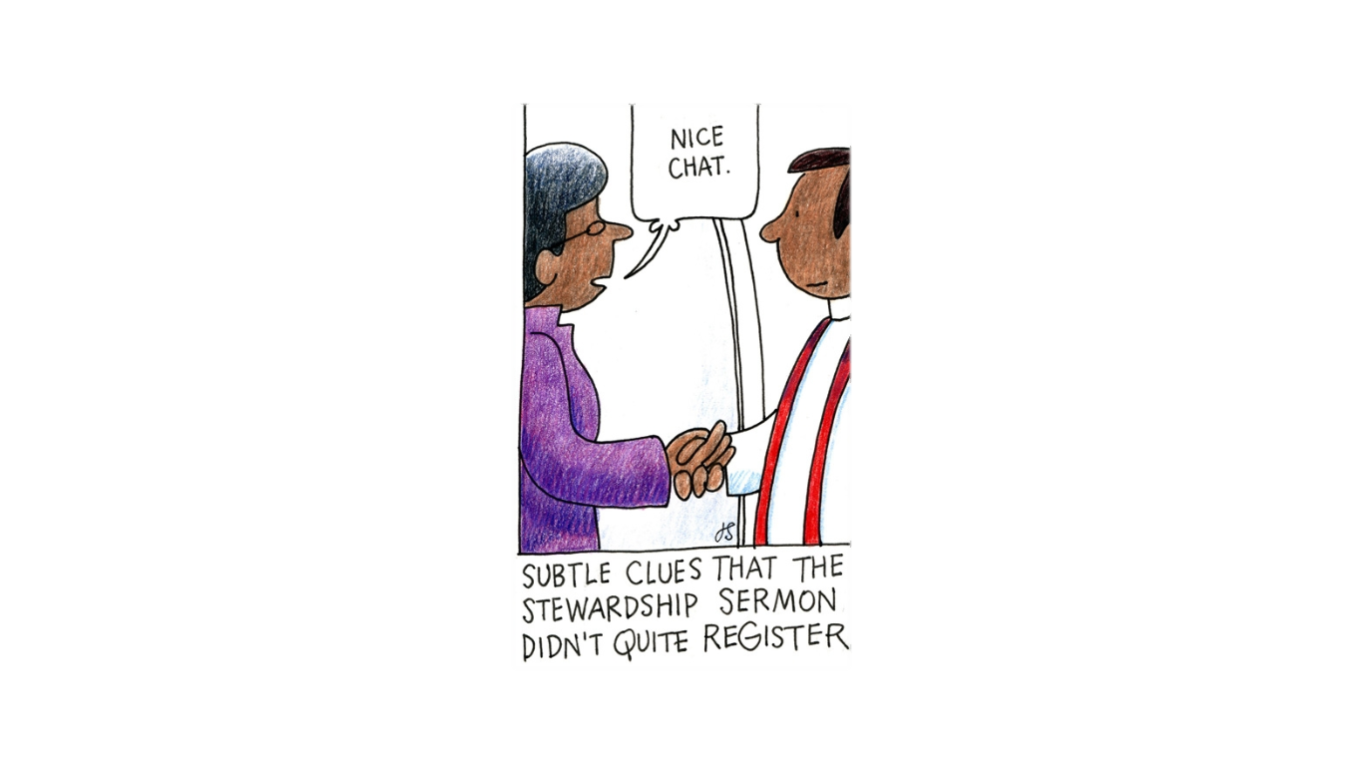

Slide 28
CORE CHURCH
Core Activities of Every Episcopal Congregation
Worship and Prayer
Christian Formation and Discipleship
Faith Community Support, Care and Fellowship
Outreach

Slide 29
Everything After “I Believe”
Every Congregation’s Annual Campaign Should Be-
To help everyone understand that stewardship is EVERYTHING after one says, “I believe in God the Father Almighty……..”.To understand that God has been ‘radically generous to us’.
Present stewardship in such a way that it is life-giving, transformative, and spiritually challenging and inspiring.
Notes:
Help everyone understand that stewardship is EVERYTHING after one says, “I believe………….”
And that the church has the responsibility to present stewardship in such a way that it is life-giving, transformative and results in a deepening of faith, strong and supported ministries and vibrant, generous congregations.
So I am going to launch into information about best practices that is a combination of everything I have learned by watching stewardship efforts in congregations, what I have learned from gifted and passionate leaders who have had years of successful work in stewardship and also about some specific programs I know about with some stories thrown in along the way. I have also created a handout with resources for you and some of the specifics from this power point presentation.

Slide 30
How Do We Improve?
To improve the culture of giving, new behaviors and
practices need to be imbedded into the preparation for the Annual Giving Campaign.

Slide 31
Best Practices
Form a stewardship team with persons who have a spiritual gift or passion for stewardship and are givers of record to the church.
5-8 members (asa of 100+)
4-5 members (asa of 40-100)
1 or more vestry, possibly Sr. Warden, plus 1 or more
of the vestry/bishop’s committee
Have detailed ministry descriptions with expectations
Team Composition:
-at least one very creative, possibly artistic mind
-persons with organizational skills
-persons who work well with others
-persons who have track records of getting things done
Notes:
So here we go.
Best Practices for Annual Giving Campaigns
First and foremost – FORM A STEWARDSHIP TEAM
This group is trusted and empowered to oversee comprehensive stewardship education and actions/programs that will help build a culture of generosity in the congregation. This includes an annual giving campaign and often an emphasis on stewardship of God’s creation. They are constant reminders to the leadership to incorporate the language of stewardship in everything the church does.

Slide 32
Work of the Stewardship Team
Gather first time together in May prior to a fall campaign
Together pray, study scripture and articles/books on stewardship
Assess historical approaches to annual campaigns of the congregation and seek to understand the church’s giving culture
Discover stewardship resources for churches, brainstorm creative and inspiring ideas
Create the plan with corresponding calendar/schedule
Plan particulars for annual giving campaigns & other stewardship endeavors for the congregation including environmental efforts
Include planning/working with persons who lead children and youth for age-appropriate stewardship involvement
Complete the plan, assure thank-yous are given to donors
Notes:
(just read list and ad lib)

Slide 33
Determine Rector’s Role
Vestry work with the Rector to determine his/her role in Stewardship and the Annual Giving Campaign
  Best Practices
  Choose stewardship formation materials to use as devotionals, prayers, study materials
  Develop/ deliver sermons based on the Christian practice of stewardship
  Work to raise the congregation’s understanding of what it means to be a steward in all aspects of personal and congregational life
  Prepare persons who will give testimonials during worship services or via video or other gatherings
  Know who pledges/makes commitments and the $ amount
  Work with the stewardship team to determine clean up procedure and be personally involved at some level in the clean up of the campaign
  Write personal thank you notes to each pledging unit, person or family, at the end of campaigns

Slide 34
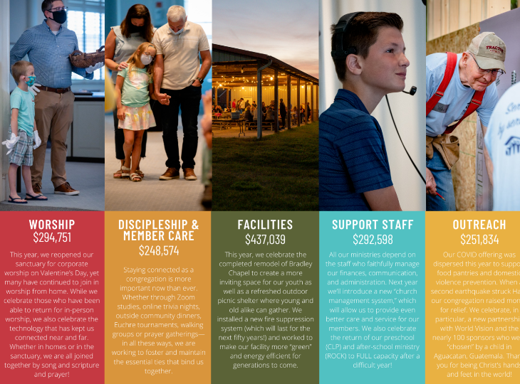
Sample Narrative Budget

Slide 35
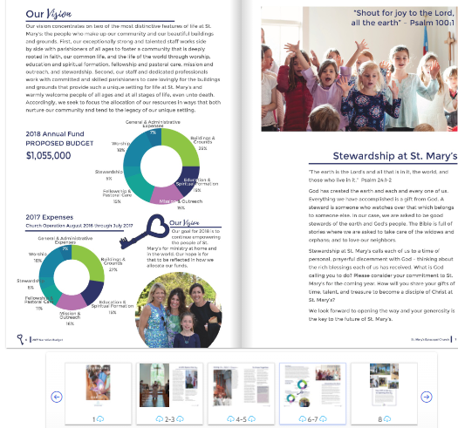
Another

Slide 36
The Process or Program
MORE THAN ANYTHING………………………..
Be Creative and Shake It Up!

Slide 37
Be Creative
Themes
Logos
Visuals
Media
Notes:
Let me give you some examples of themes I have seen used:
Celebrating God’s Abundance
First Fruits
Hope, Faith and Generosity
In His Steps (used for percentage giving emphasis)
Harvest Sunday
Thank You Lord!
Giving Back to God
Extravagant Generosity
God is Great, God is Good, Let Us Thank Him
If you can’t come up with a theme google ‘stewardship logos themes’ and countless examples pop up, yours for the stealing
I have seen logos created and used on flags flown outside the church, put on banners , letterheads, pledgecards, you name it.
The visuals can be pictures of people from your congregation engaged in ministries of outreach and generosity, props used during stewardship testimonials and sermons to make them memorable. But this has to be something that is encouraged and expected. I recently heard a stewardship sermon where a beautiful lily was used to remind people that just as lilies are so God will take care of us and why do we worry. I showed you the apple example. You are only limited by your imagination and fearlessness.
And media. I have put on your list the name of a dvd that is a powerful testament to the abundance in America and how we are called to give back to God out of our gratitude. It is called RICH with Rob Bell. Let me tell you how we used it in our congregation.
We asked our rector if we could show it in lieu of the sermon and then pose 2 questions about it that people in the pews could turn to someone sitting next to them or behind them and ask each other. Our stewardship committee was scarred about the reaction we might get, but found that people not only were inspired by the video but didn’t want to stop talking about the questions! We got tons of positive feedback from taking this one Sunday and thinking outside the box during our annual giving campaign a few years ago.
I knew of a church that had a big bulletin board and pinned up decorative little cutouts of gift boxes with the names of any pledging family, not the amount but the name. The vicar said it inspired people to not only give but to give early!
A number of our churches create a utube video for the stewardship drives. One church in our diocese last fall had a utube video of 4 people who gave their giving testimonials on the utube, speaking directly to other members of the church about how giving to God through their church had changed their lives.
You saw the Skinny on Tithing. That is available on the diocesan website with the web address on your handout.

Slide 38






Stewardship Themes & Logos

Slide 39
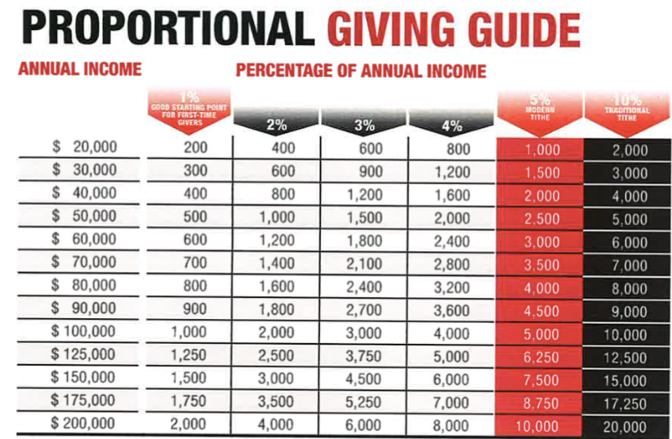

Slide 40
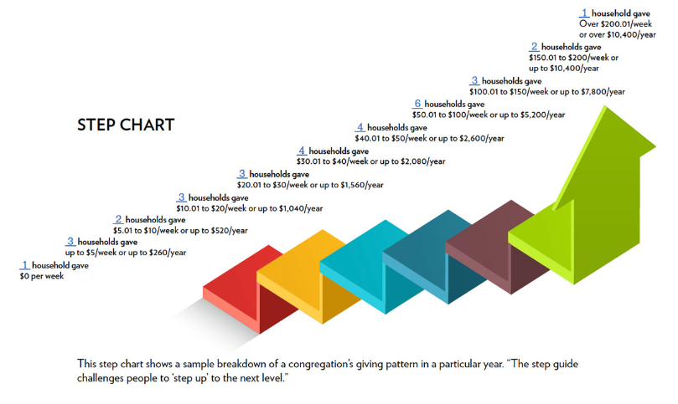

Slide 41
Liturgical Emphasis
Include in your worship services a visible, tangible expression of stewardship and gratitude
Examples:
-people place their pledge card ON THE ALTAR
-note cards filled out in church thanking God for….are placed in alms basin
-small items or mementos are distributed after communion to remind people of God’s generosity
-art related to the theme remains for 4 Sundays -people place at the base of the altar symbolic items
representing their gratitude to God

Slide 42
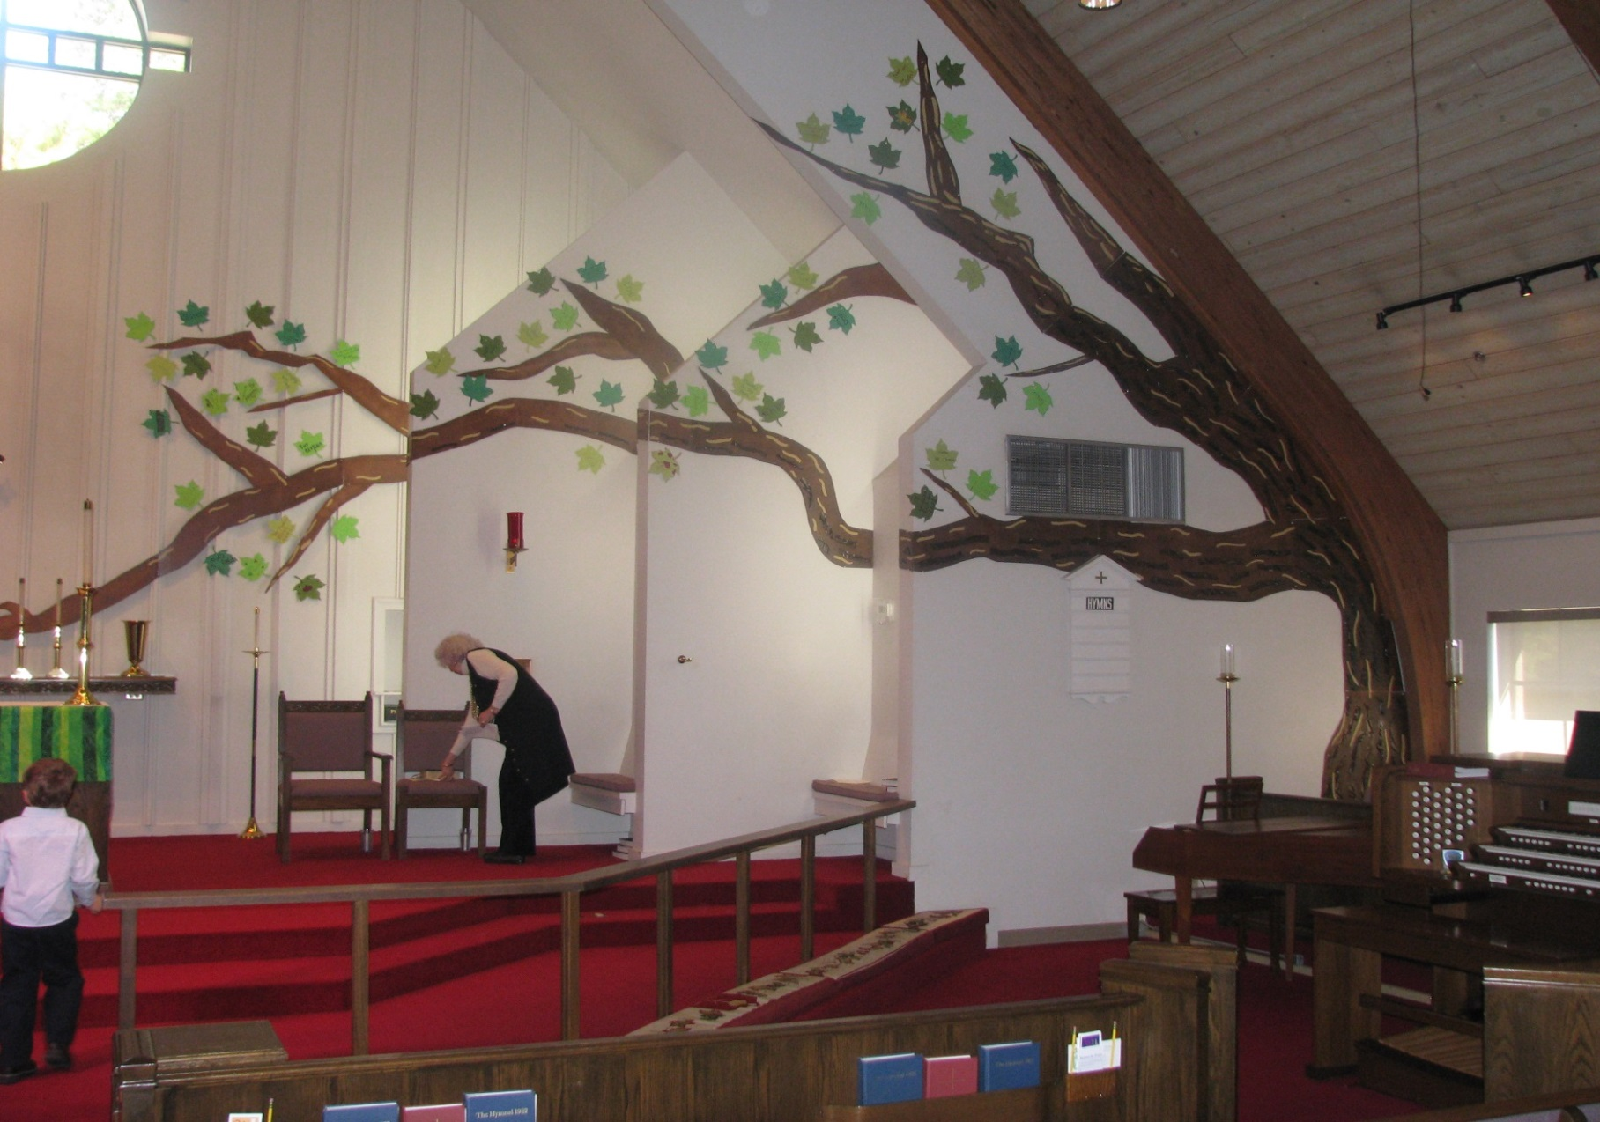

Creativity

Slide 43

The Use of a Stewardship Metaphor

Slide 44
A Sampler of Ideas
Special hand-written letter campaign
Custom sticky notes – I thank God for…..
Short movie instead of sermon with discussion
Video message from children of church about being grateful
Uniquely written daily devotional written by members of the parish
Home groups given special materials to study and discuss
Cardboard testimonials given during worship “I am thankful…”
Members asked to bring tangible items that represented joy in their lives to place at the foot of the altar prior to the service
Clothesline strung up in hallways for people to post pictures of family and fellow church members actively engaged in church activities/missional work under theme “Thankful for This Family of God!”
Have a “Pay It Forward Week” during the campaign
Dedicate one Sunday during the campaign to “Church Leaves the Building”
Email videoed testimonials from agencies the church has helped

Slide 45

Rise Up,
Here I Am Lord!
An Annual Campaign Story
St. Aidan’s Episcopal Church, Cypress, Texas

Slide 46
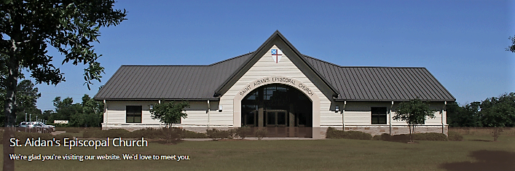
The Context
NW Suburban Houston (Cypress)
15 year-old church, 8 year-old building, contemporary Episcopal worship
2 Income Families-many working for oil related industry, commuters
Average Age: 30s-40s, lots of children
Lots of Mortgages and Personal Debt
Average Sunday Attendance about 200
Full time priest, 4 part time staff
And it was 2016 – the year oil bottomed out
20% of income from commercial billboards ($55,000 a year)
Looming need for a capital campaign for building expansion

Slide 47
They Understood the Essentials
Teamwork and prayer starting 4 months in advance
A plan which grounded the message in the story of their mission
Theme based on scripture with visuals utilized on all campaign materials
Unique creative element, different from previous campaigns
Sermon series focused on theology of stewardship
Inspirational materials-bulletins, email reflections, adult formation opportunities, videos
Leaders, clergy and lay, pledge first
Generationally and some individual separated approaches
Online giving alternatives
Lay testimonials
Ingathering Sunday, thank you notes, campaign clean up

Slide 48
Primary Focus on God’s Generosity
Giving to God Motivated by Thankfulness
Significant Scripture and Story as Relates to God’s Generosity
Low Key Budget Emphasis and Budget Narrative Materials
Focusing the Message on the Work of Mission
Asking for a Response Through Tithe /Proportional Giving

Slide 49
An Inspired Meeting

Slide 50
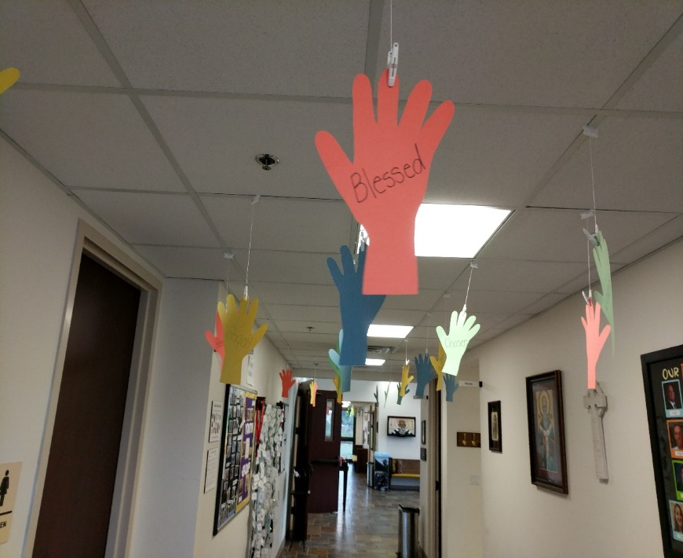
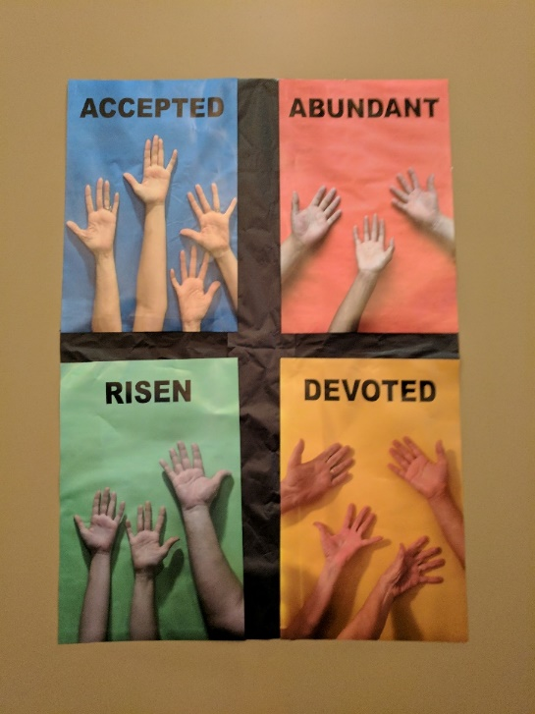
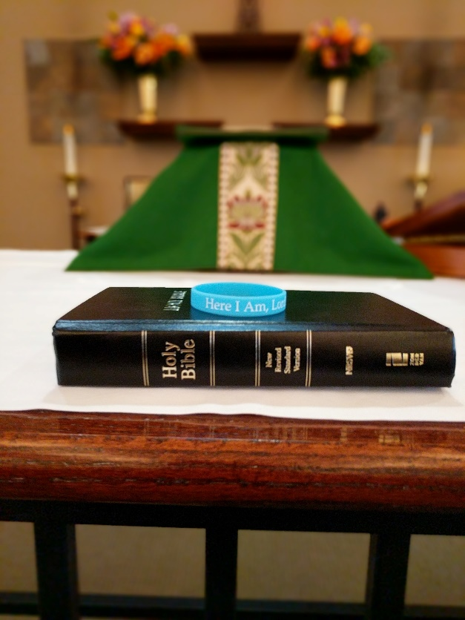

Slide 51
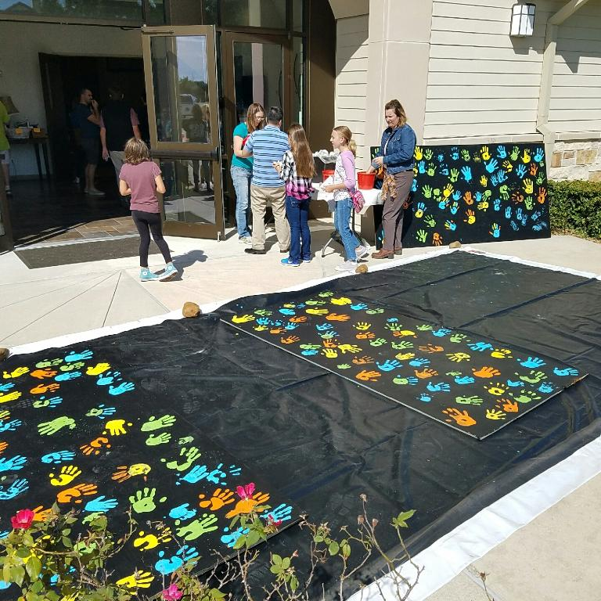
The Billboards Became Canvases

Slide 52
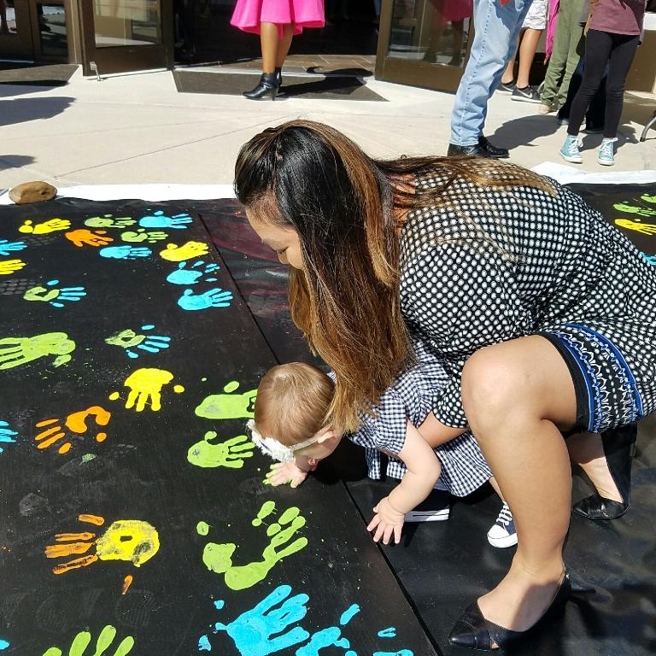
Every Member, Every Age Said,
“Here I Am Lord”!

Slide 53
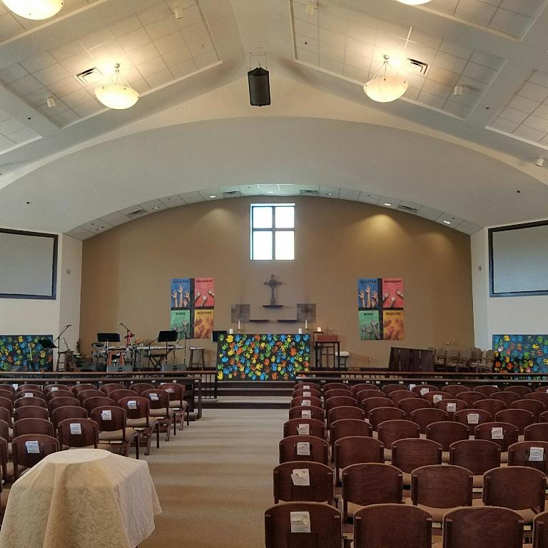
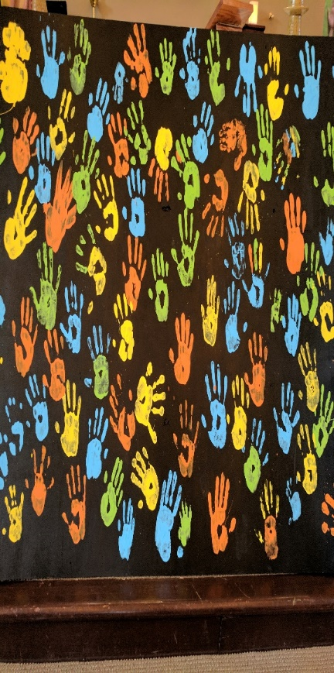


Slide 54
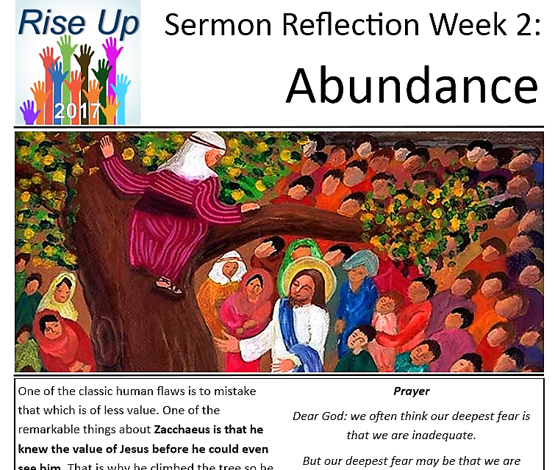
Meaningful Resources
Prayers, Reflections, Lyrics, Scripture References that tied into the four aspects of the theme and the sermon series:
Acceptance
Abundance
Risen
Devoted

Slide 55
What Happened?
“The entire culture of giving here changed in 2017. For the first time we moved away from focus on the budget to God’s abundance in our lives. The people of St. Aidan’s increased their commitment to God, not just this congregation, as a result of this campaign.”
The Rev. Les Carpenter
Pledges came in faster than ever
6 Households at least doubled their pledge
Average pledge increased by 12%
Many families by year end gave significantly more than they pledged
Many large one-time gifts came in
Exceeded lost billboard revenue
Continued into 2017 with a successful capital campaign

Slide 56

Why the Great Results?
Leaders Became Fearlessly Faithful
Emphasis on Giving to God through the Church’s Mission and Vision
Coordinated Team Effort, Focus, Plan, Hard Work
Challenge Was Integrated into Creative Approach
Continuous Visual Reminders Thru Various Media
Every Person Given Opportunity & Expected To Engage in Campaign

Slide 57
Programs Other Than TENS
1. In His Steps
2. New Consecration Sunday-Herb Miller
Common between the two:
Holding back pledge cards until an ingathering during worship at the end of the campaign
3. Simple Enough – Andy Hamilton

Slide 58
Your Turn To Talk
Turn to a few people next to you and share the following:
    One creative theme/element or change from the norm in an annual campaign for your church that you thought was effective and why
    If you can’t recall a creative element or change, talk about your church’s current process in planning an annual campaign and your thoughts about how it could be improved.

Slide 59
Pr
Practically

Slide 60

Take a Look at the TENS Resources!

Slide 61

The Episcopal Network for Stewardship
TENS
www.tens.org
2022
Fall Campaign Materials
In English & Spanish
pw: Luke9:17

Slide 62
2022 Fall Campaign Materials
Detailed Campaign Timeline
6 Weeks of Reflections
Sample Letters
  Rector/Vicar
  Sr. Warden
  Campaign Chair
  Pledge Card/Proportional Giving Chart
  Special Prayers of the People
  Original Hymn on Theme
  Logos/Artwork

Slide 63
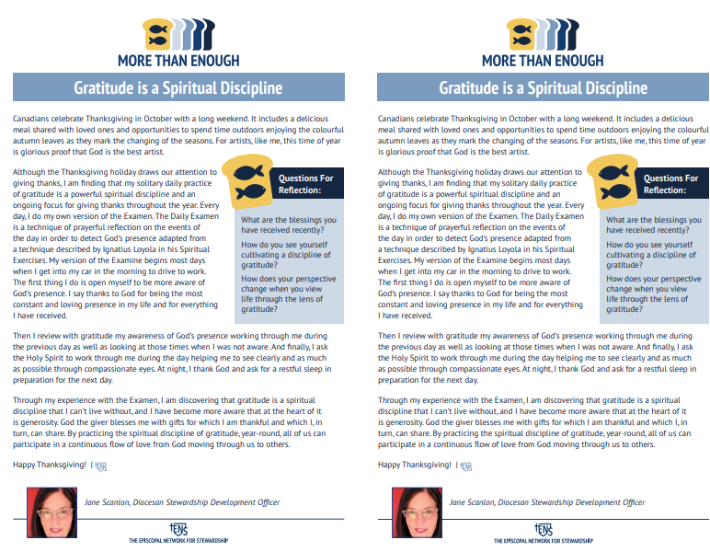
Sample Weekly Reflection

Slide 64
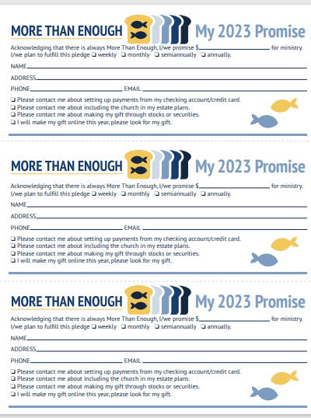
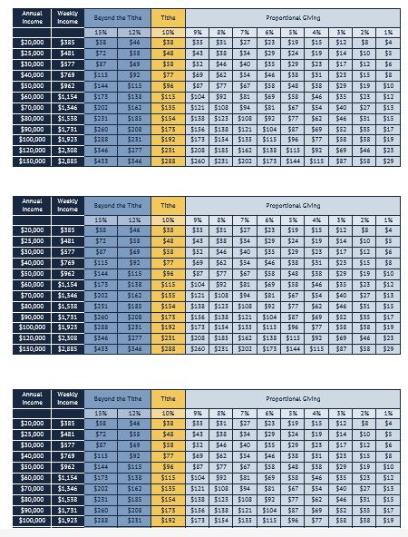
Promise/Commitment/Pledge Cards with
Proportional Giving Chart

Slide 65
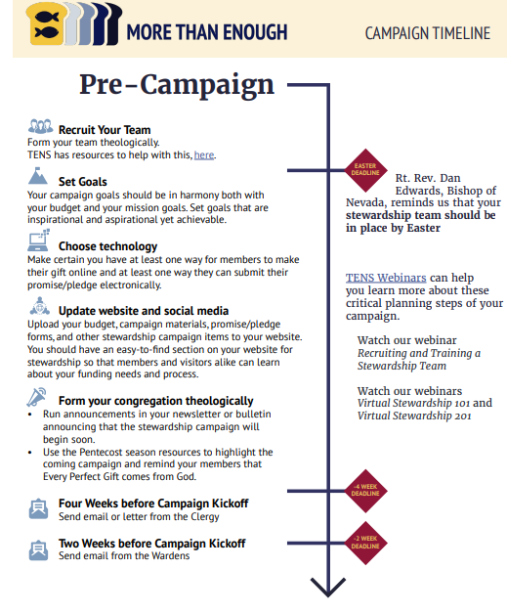
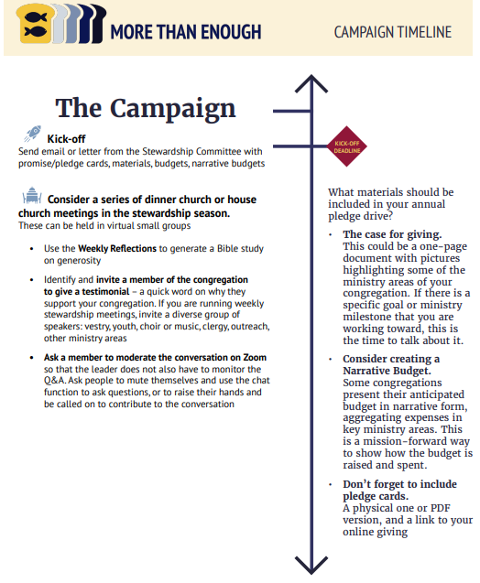

Slide 66
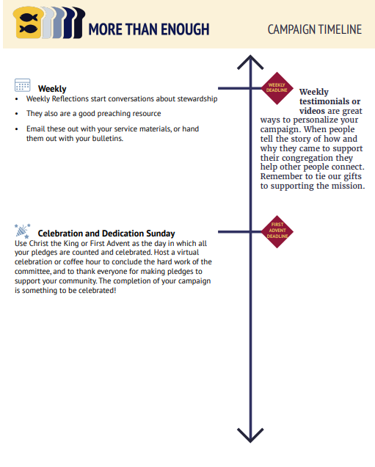
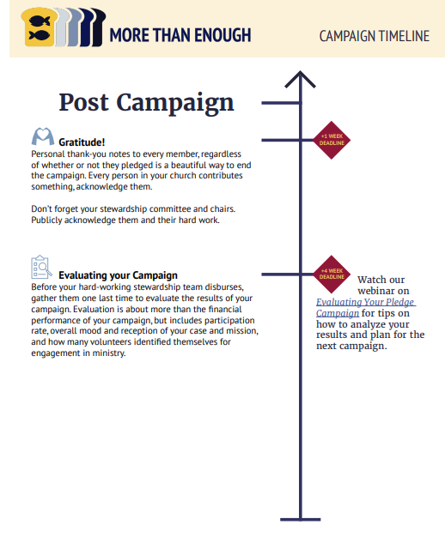

Slide 67
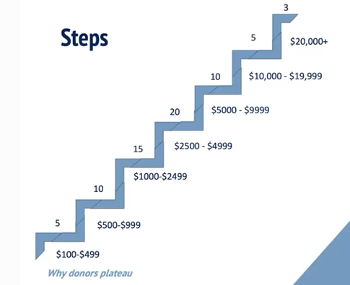
Analyzing Giving

Slide 68
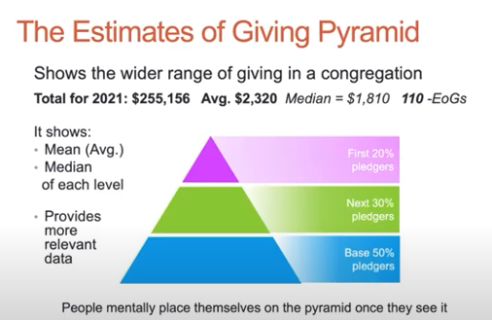

Slide 69
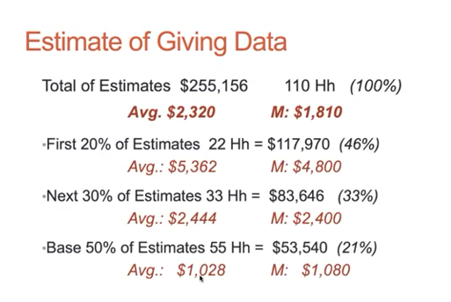

Slide 70
Review of My Recommended
Resources List

Slide 71
Your Thoughts
What did you learn from this presentation that causes you to think about your own stewardship and annual giving campaigns at your church?

